Slide 1

LocalSquare
A platform to connect and enhance physical
communities and groups

Slide 2
Agenda
Introduction
Project design
Outcome
Demo
Q&A

Slide 3
What is the problem LocalSquare is trying to solve?
Many factors, including digital technologies, have created communities that are less connected and harder to get involved with.
Digital technologies are built to keep people online and work against physical communities and groups.
Most social media platforms are not built with physical communities in mind. They serve to connect people over the internet, but actually decrease people’s overall social connectedness.
It is especially hard for the younger generations, or people moving to new locations to get involved in community.
The lack of social connectedness has been demonstrated to have a negative impact on people’s wellbeing, both physical and mental.

Slide 4
What is the desired state of digital technologies in relation to social connectedness?
LocalSquare’s vision of the future, is a world where a person can move to a new town or city, knowing nobody, and rapidly and effortlessly connect with the people around them and get involved in their local community.
Notes:
They would start by searching for groups in their area on LocalSquare, where they would ask to join the groups they were interested in. Once joined, they would be sent a welcome pack with all the information a newcomer might want to know. What activities there are, other groups they might want to be a part of, community facilities, etc.
From there they would be able to interact with other members, find information about local activities, events, notices, etc. They would be able to find all the other related groups easily by group associations, find important members in their community, such as JOPs, council members, builders, plumbers, and also perhaps find local businesses.
The vision is a place where any kind of physical group can easily create an online platform that suits the needs of their group, and works as a funnel to get members of their community to connect and interact with one another in a physical manner, not just online.

Slide 5




What solutions are already out there?
Notes:
Next door - 11 countries, limited functionalities when it comes to finding local activities, no flexibility for creating unique groups, can’t create individual groups
Meetup - only does events
Facebook Groups - Part of a bigger platform that wants to capture your attention and feed you ads (aggressive business model), limited functionalities
Discord - Good for online groups, but limited functionalities for physical groups

Slide 6
What sets LocalSquare apart?
It focuses on creating healthy environments to help communities flourish, not making profits off users with aggressive business models.
It is flexible and lets users create their own unique groups
It focuses on physical communities, and bringing people together, rather than keeping them on the platform
It lets users browse groups based on group relationships. For example, you could find all groups that are children of a broader town group.
It does not try and do things that people already have good solutions for, such as direct messaging.

Slide 7
Industry / Overlap
LocalSquare is in the Social Media / SAAS industry.
It has the potential to overlap with many industries based on how the groups are used. Such as overlap with any number of local businesses.

Slide 8
Stakeholders and value
Community Leaders
Community leaders can use LocalSquare to encourage participation and a build a more connected community.
Community Members
Community members can use LocalSquare to be more involved in their community, find information, and connect with others.

Slide 9
Design

Slide 10
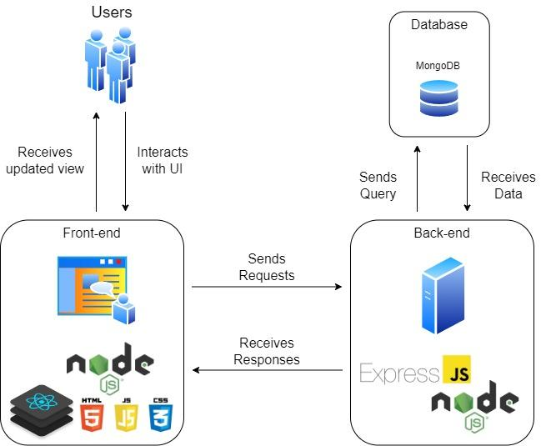
Product architecture

Slide 11
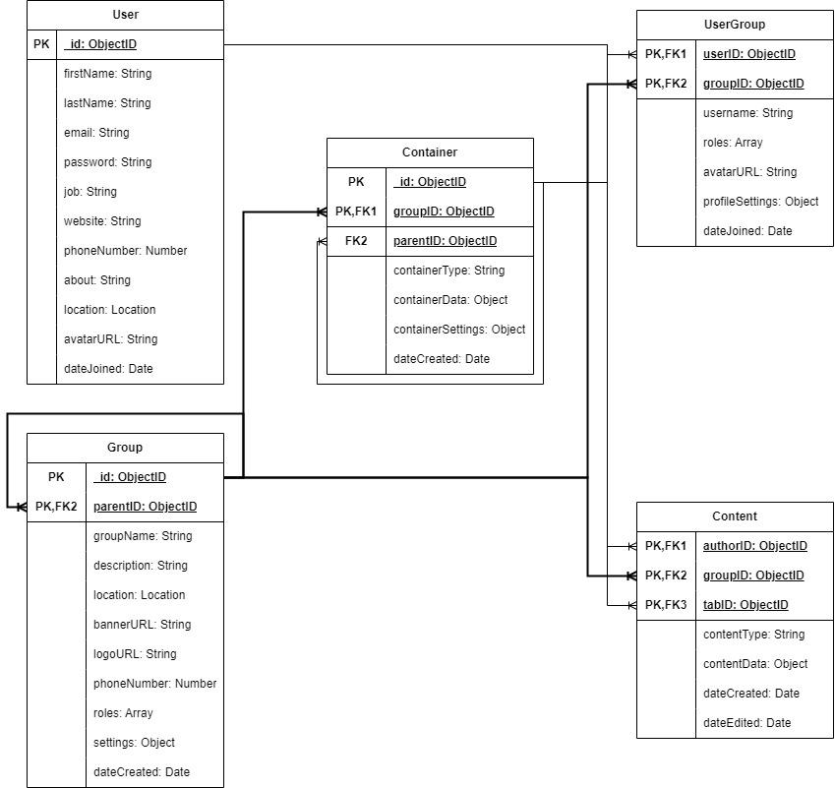
Database

Slide 12
User Stories
# | User Story Title | User Story Description | Priority | Additional Notes
1 | Signing Up | As a user I want to be able to sign up to LocalSquare | High
2 | Logging in | As a user I want to be able to log in to my existing account and have an option to keep me logged in. | High
3 | Creating a group | As a user / community leader I want to be able to create a group with default or custom settings. | High
4 | Finding a group | As a user I want to be able to be able to search for groups based off filters, tags, and location. | High
5 | Joining a group | As a user I want to be able to request to join groups | High
6 | Accepting join requests | As a group admin I want to be able to accept group join requests. | High
7 | Adding a tab | As a group owner I want to be able to add a tab to the group, and select what I want the content of the tab to be. | High
8 | Adding content | As a user I want to be able to request to add content if I need permission, or add content if it is open for anyone to add content. | High
16 | Setting permissions | As a group admin I want to be able to set permission settings for different aspects of the group. | High

Slide 13
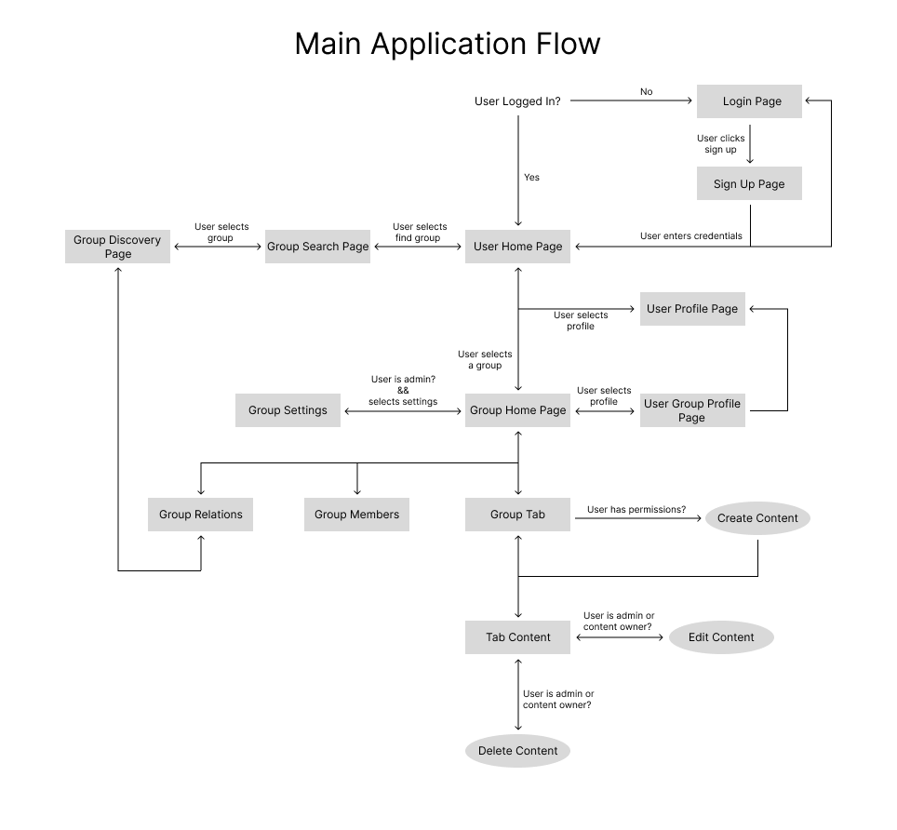
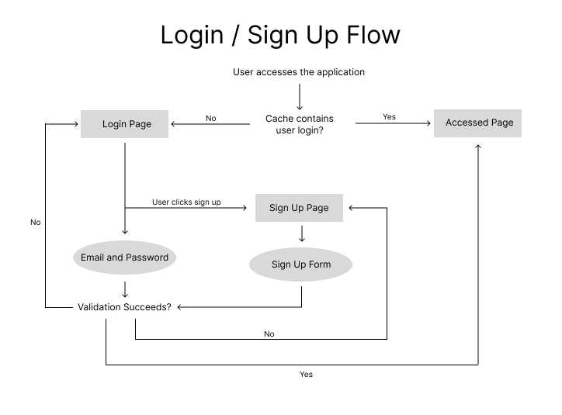
User Flows

Slide 14
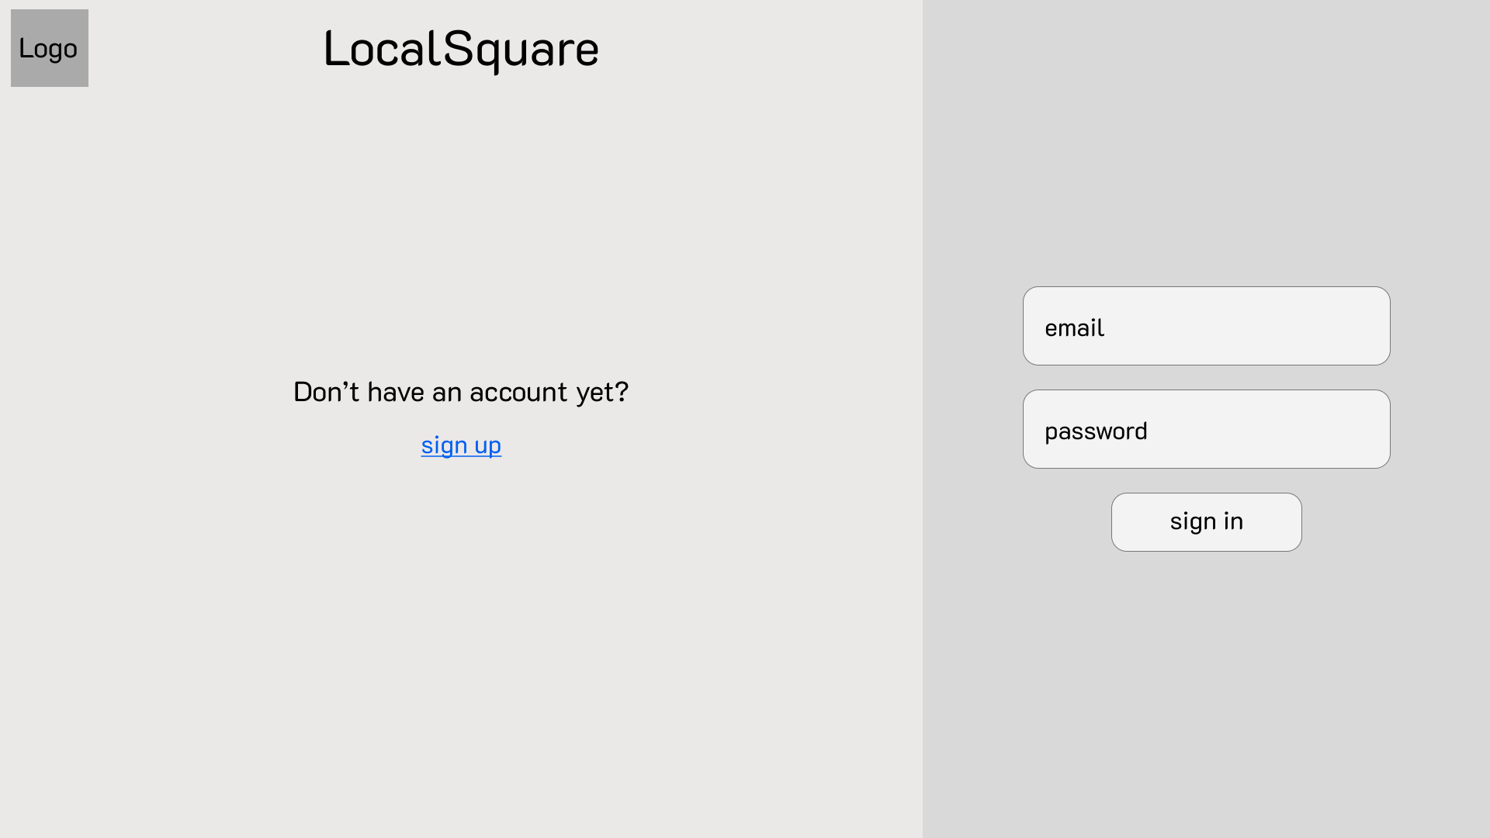
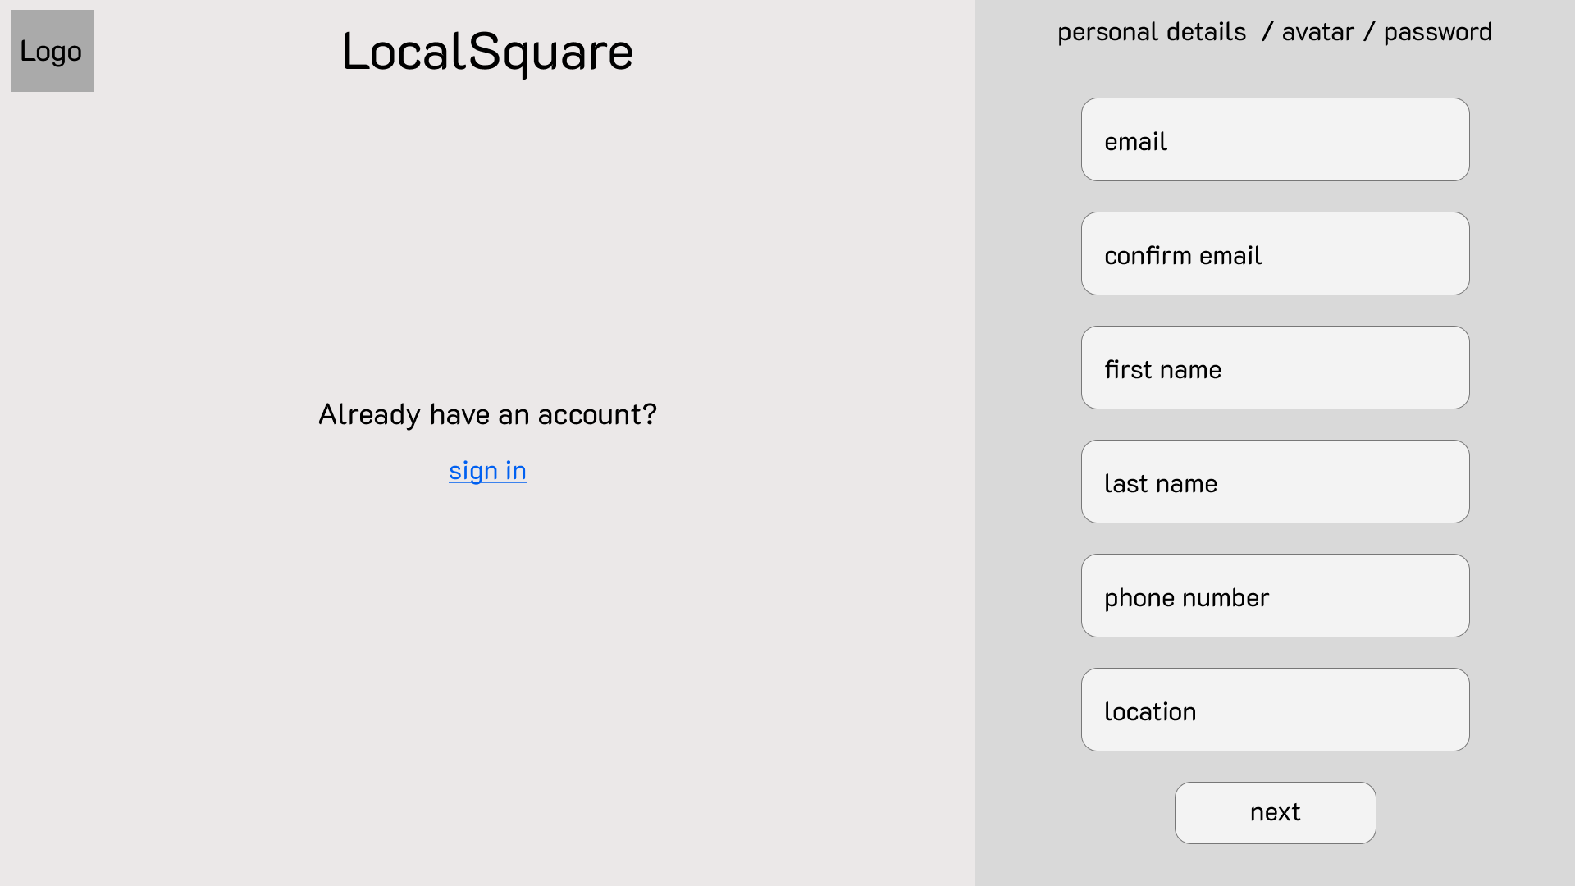
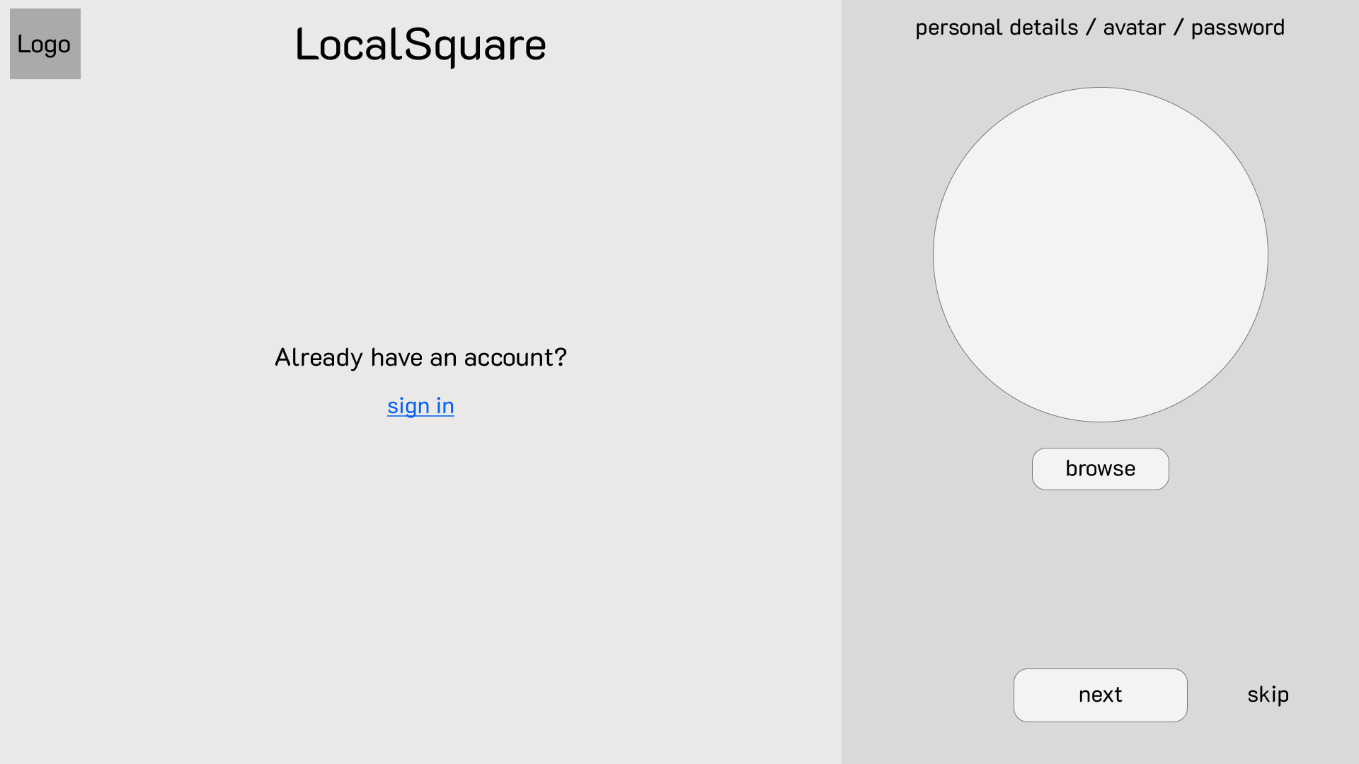
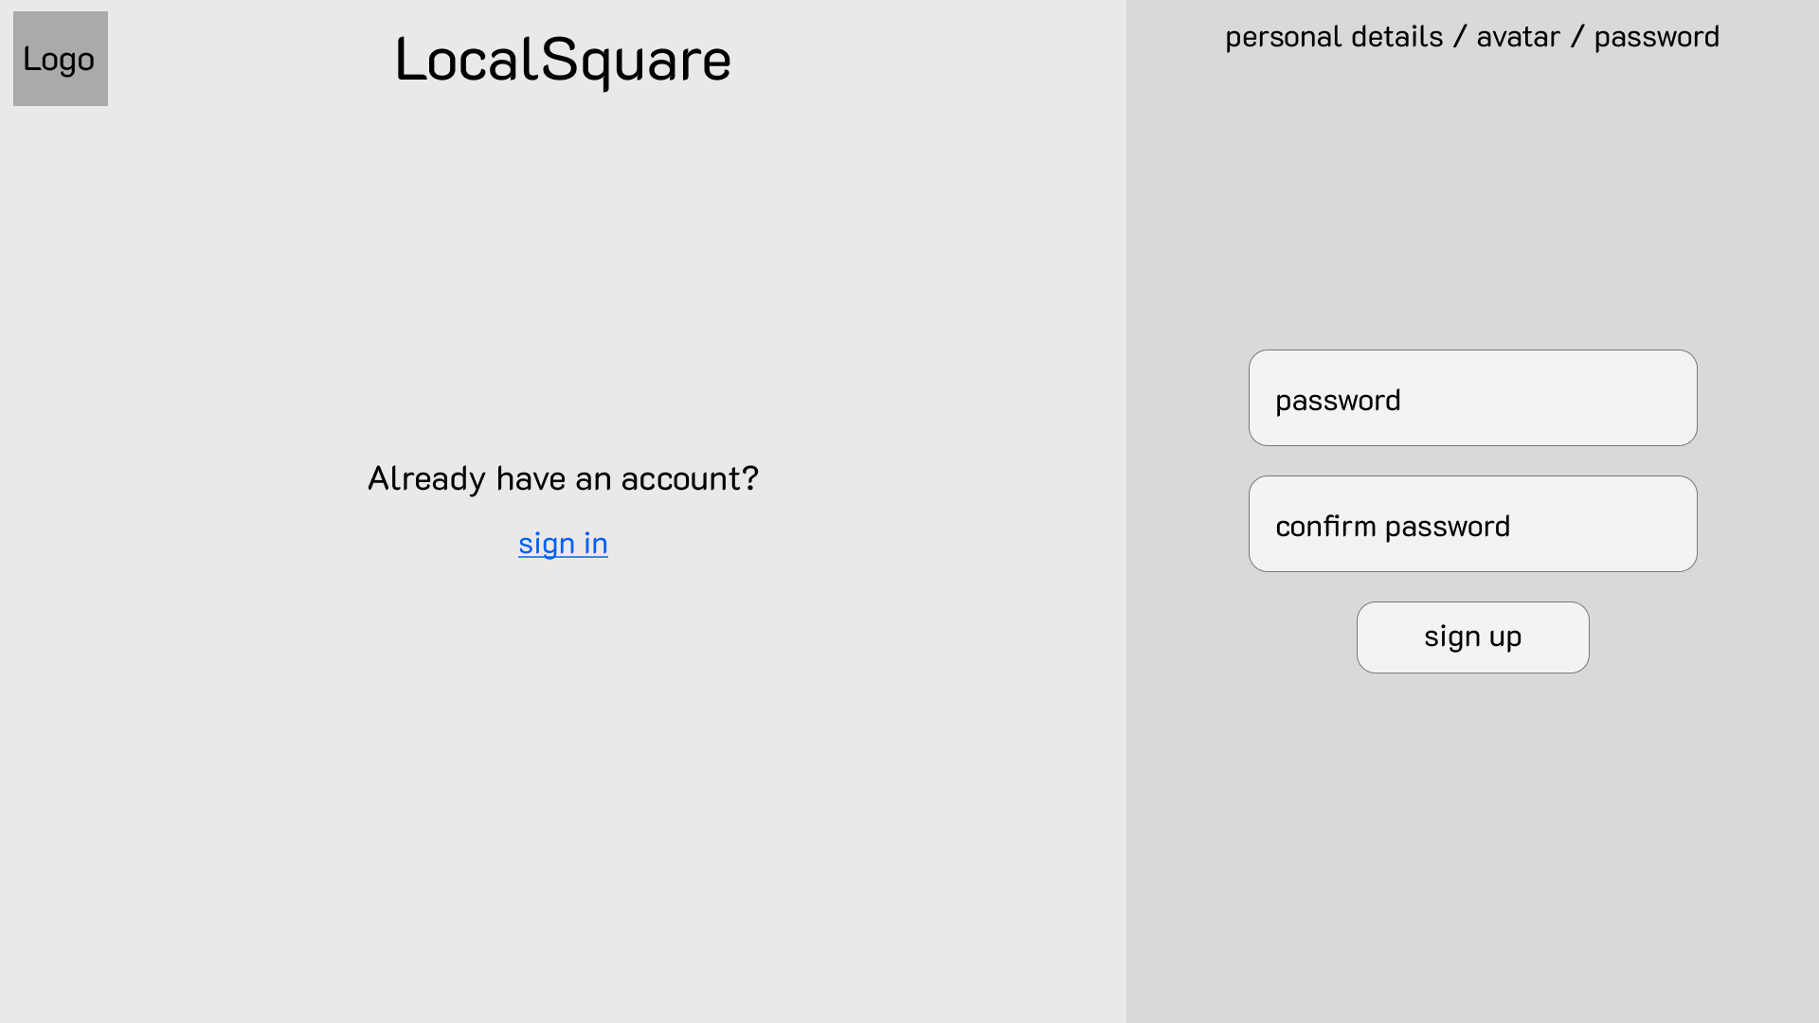

Slide 15
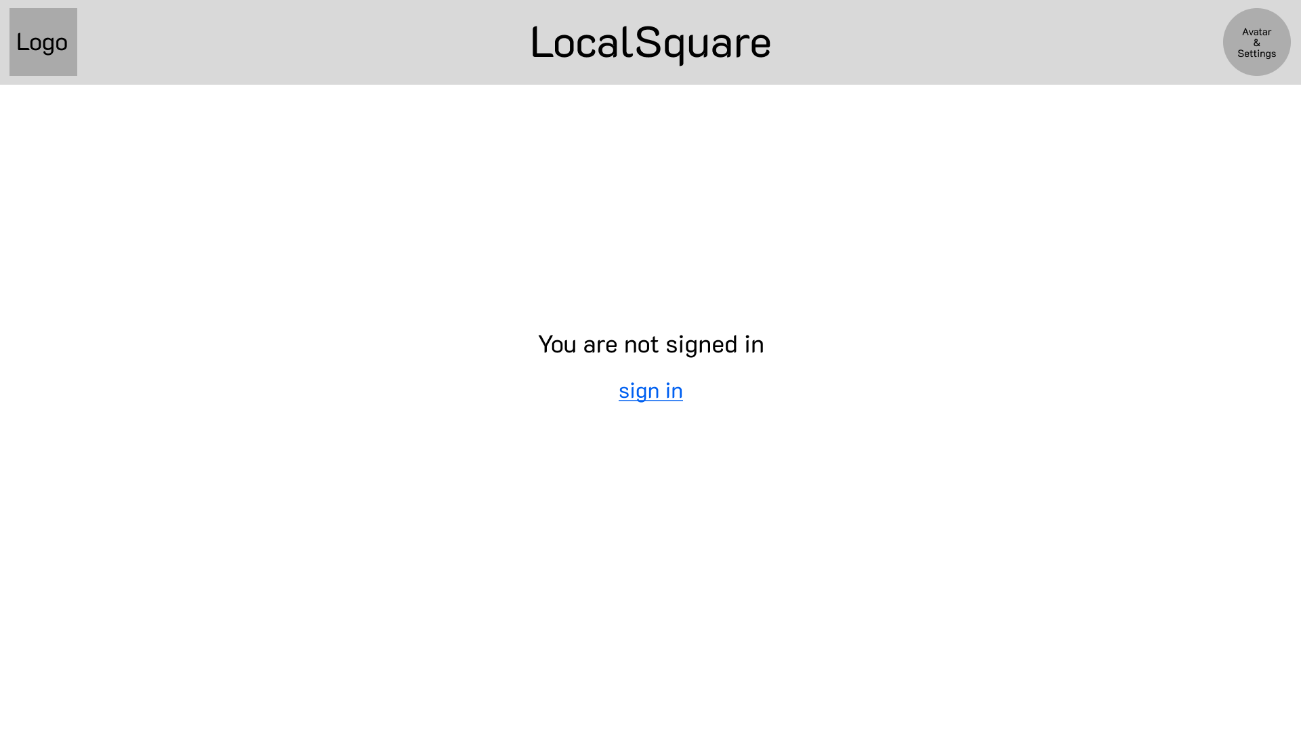
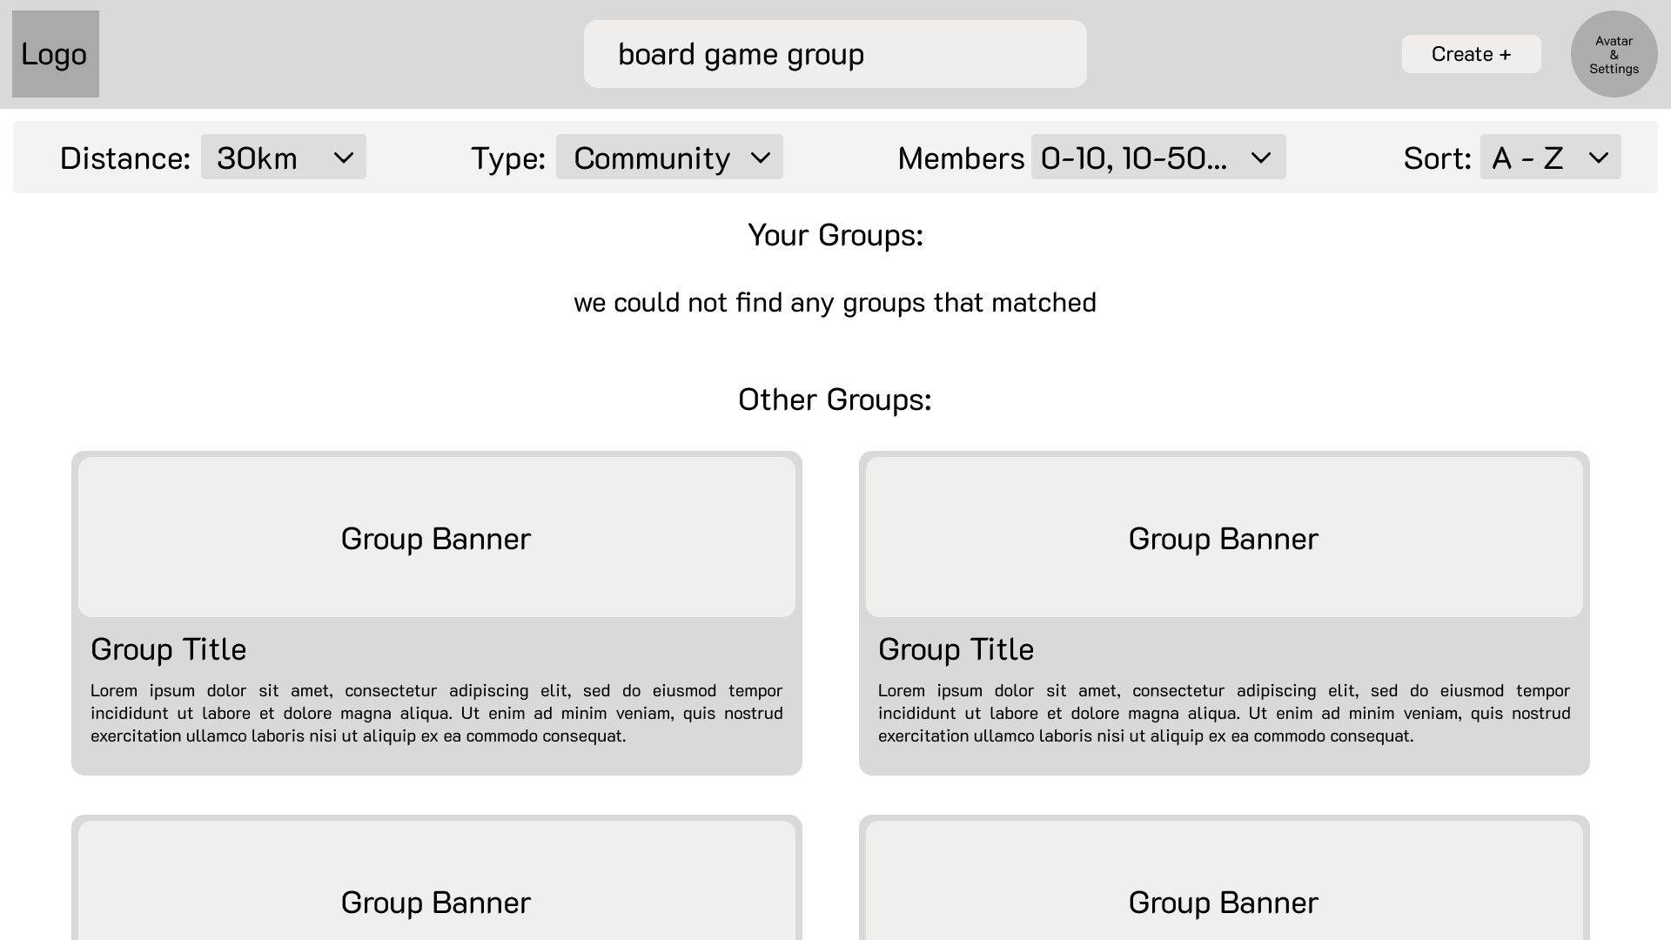
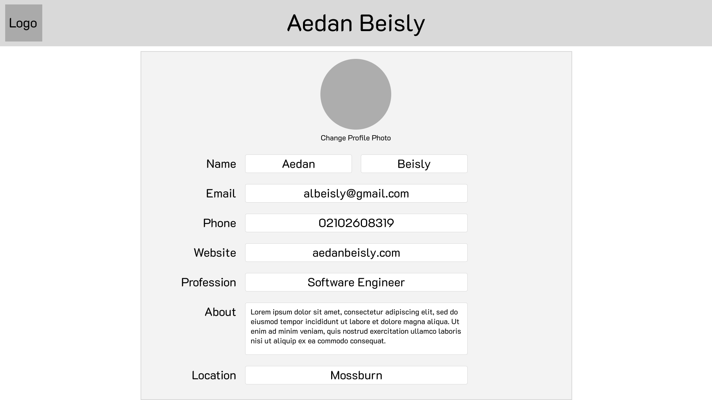
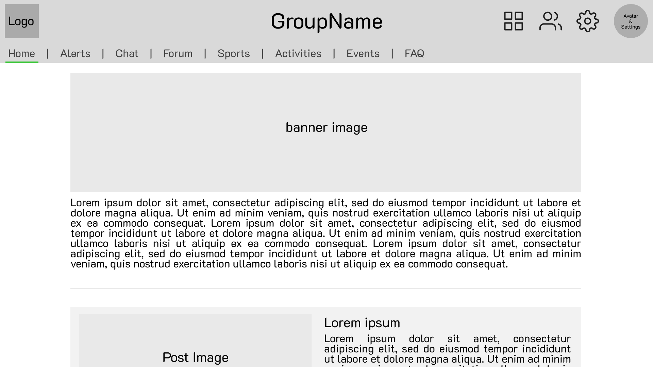

Slide 16
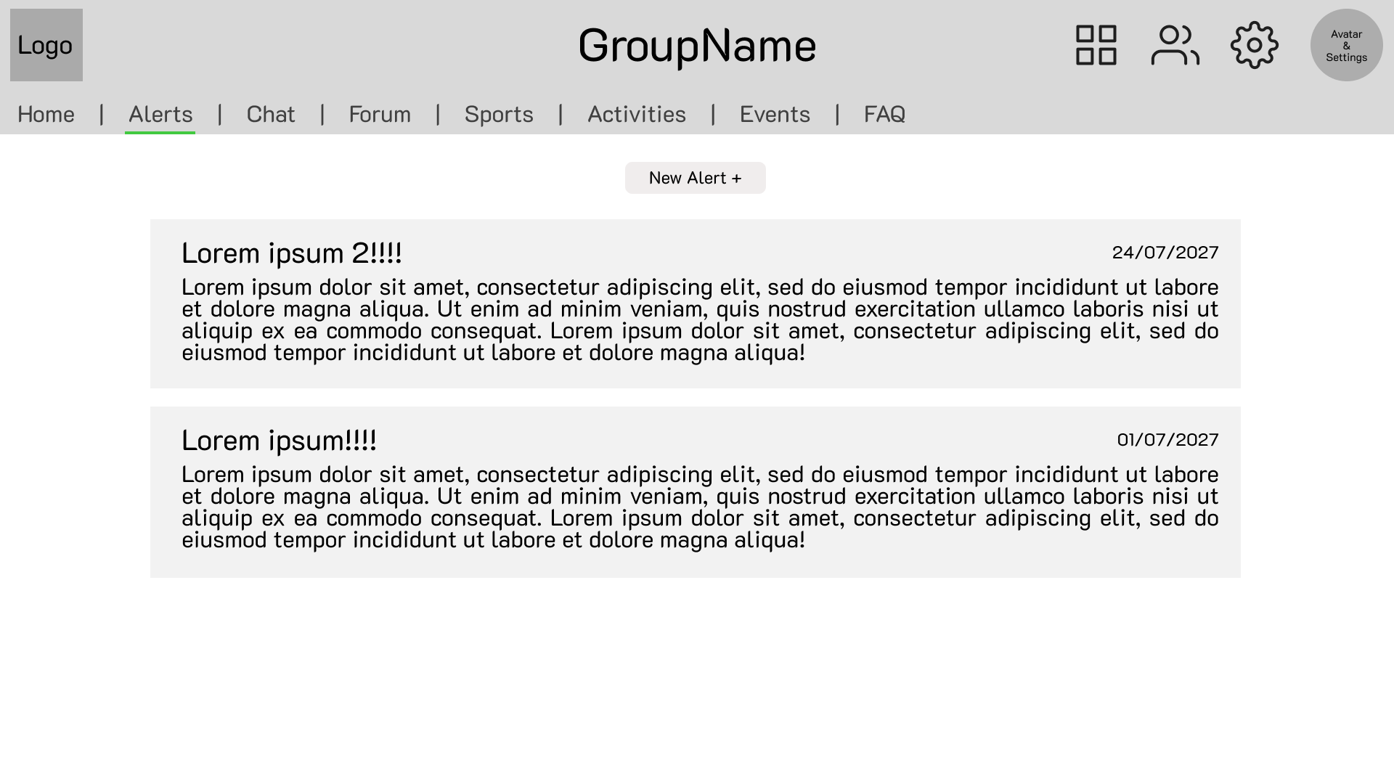
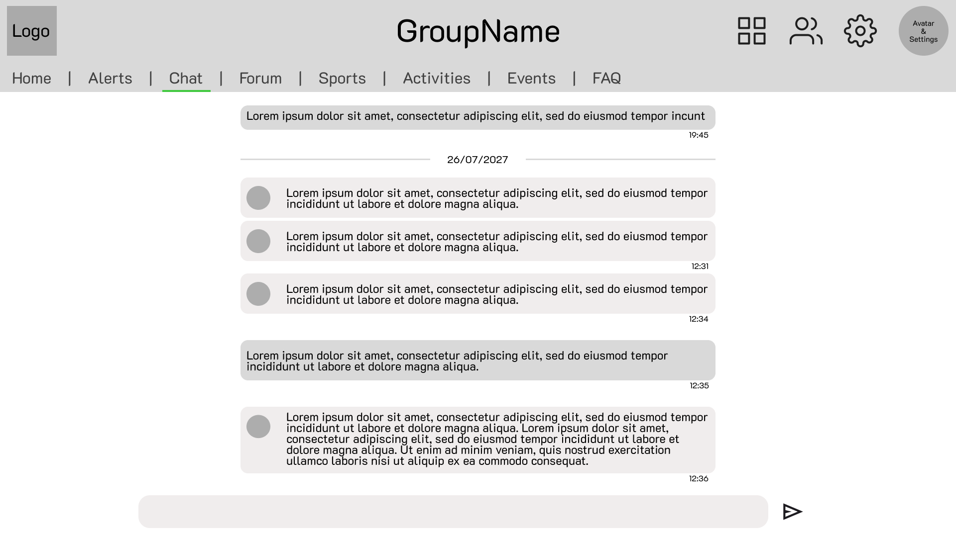
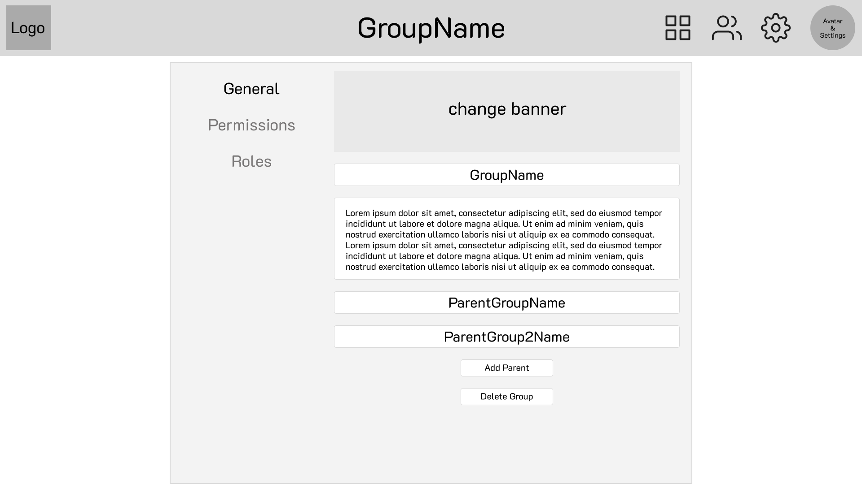
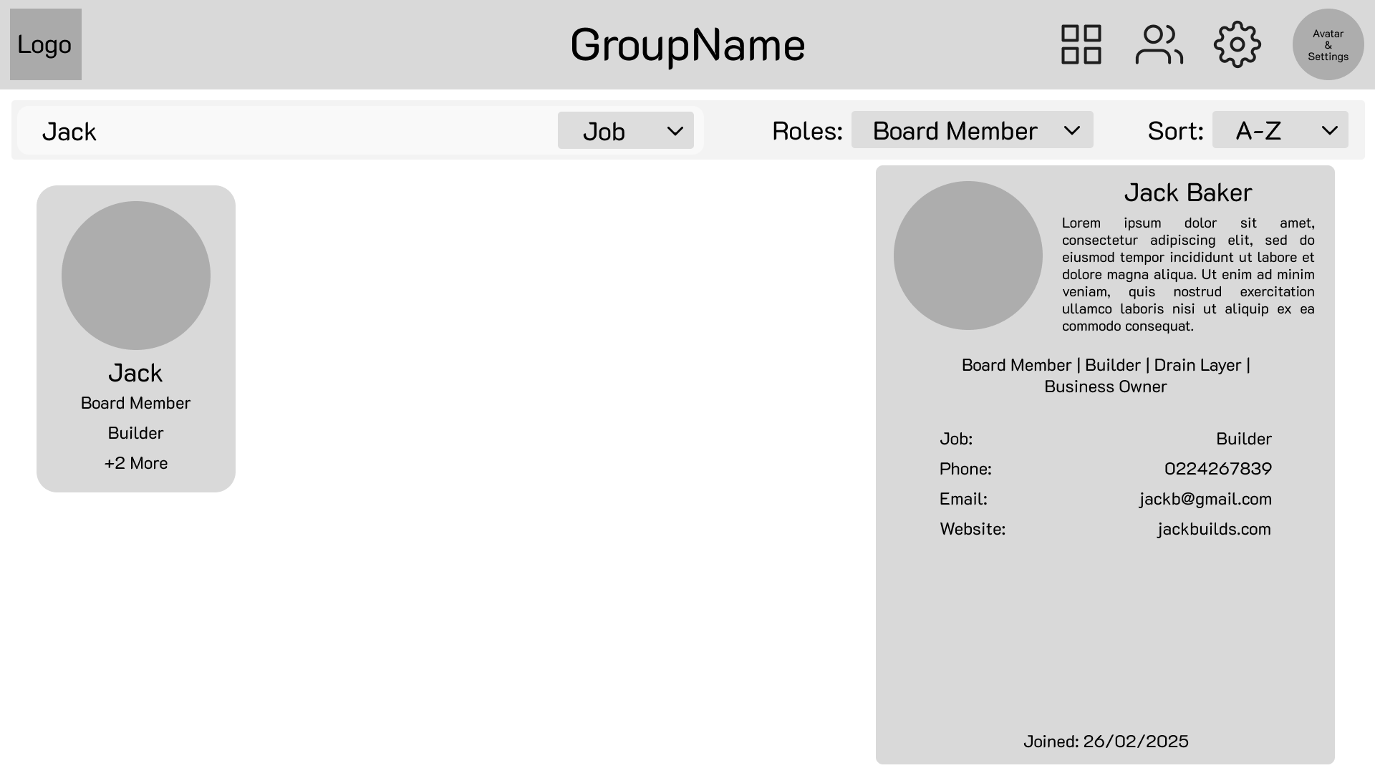

Slide 17
Out of Scope
Any of the user stories with a priority of moderate or low were only undertaken if time allowed.
Deployment was not undertaken because of time constraints.
Other out-of-scope functions:
Email Validation
Login with RealMe or similar authentication providers
Payment systems for monetization
User verification (make sure the user is who they say to help keep communities safe)
Subscribing to the feeds of other group tabs (e.g. events could be passed to parent groups' event feed)
Media storage
Media compression

Slide 18
Non-functional Requirements
Security:
Login credentials kept safe
Personal details kept safe
Group content only accessible to those with accepted join requests
Ease of use:
The application should be very easy to use, so that a person of almost any demographic can use the application to connect with their community
Speed and Reliability:
The application should be fast so that users have a good user experience, especially with the real-time features such as the chats, and it should be reliable so that users are not confused or put off by unexpected behaviour from the application.

Slide 19
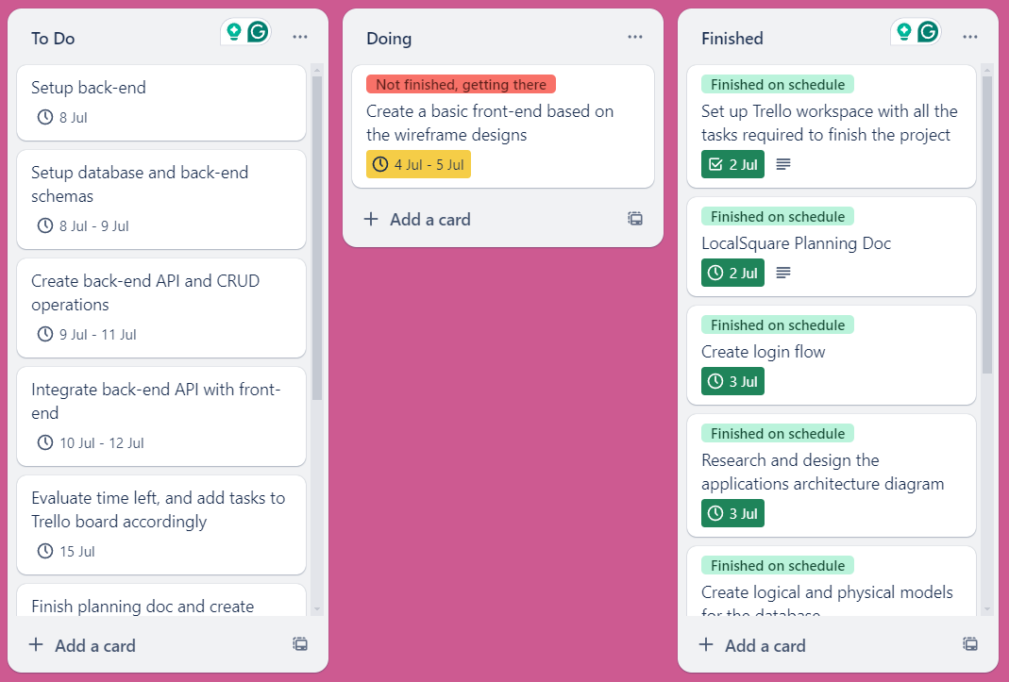
Project planning: Trello

Slide 20
Testing
Manual testing
I tested the full application as I completed each section, and afterward. I used console logging to debug issues, and fixed them as soon as they came up.
Integration Testings
Testing frameworks were used for testing the endpoints, namely Chai, Mocha, and Supertest were used to write and run the tests.
Unit Tests
Unit tests were used to test some individual code blocks, some of the same testing frameworks as with the endpoint testing were used to write the tests.

Slide 21
Implementation
The following architecture and requirements would be taken into account when implementing the application
Architecture:
Computing: AWS EC2
Files: AWS S3
Caching: Redis
DNS: AWS Route 53
Database: Mongo Atlas
Future requirements before implementation:
Better designed UX
More options for tabs and content
Data security / encryption
Endpoint security / restricted access
Mobile options

Slide 22
What was the outcome of the project?
LocalSquare turned out great! It is a functioning social platform that enables users to undertake all the high priority tasks defined in the user stories, and some of the moderate priority tasks.
It has real-time chat rooms, customisable groups with dynamic tabs and content, user searching, and permission features.
It provides a clean and understandable user experience, and is well on it’s way to solving the problems it set out to fix.

Slide 23
Resources Used
Frontend:
NodeJS
React
Vite
React-Bootstrap
Axios
React-router-dom
React-Icons
Socket.io-client
Backend:
NodeJS
Express.js
Mongoose
Dotenv
Socket.io
Axios
Nodemon
Other:
MongoDB
Thunder client
Chai
Mocha
Supertest

Slide 24
Demo

Slide 25
Q&A

